Slide 1
Catalytic Property of Cobalt(II) Ions
To demonstrate the catalytic property of cobalt(II) ions
To demonstrate the formation of coloured ions of transition metal
To demonstrate that transition metals can exist in more than one oxidation state

Slide 2
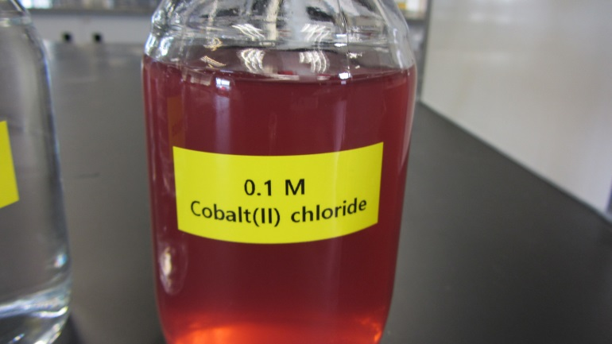
Background
When mixing a potassium sodium tartrate solution and hydrogen peroxide solution at room temperature, however, it was found that this reaction proceeds very slowly.
However, when a few drops of aqueous cobalt(II) chloride solution is added into the warmed reaction mixture, gas bubbles form vigorously.

Slide 3
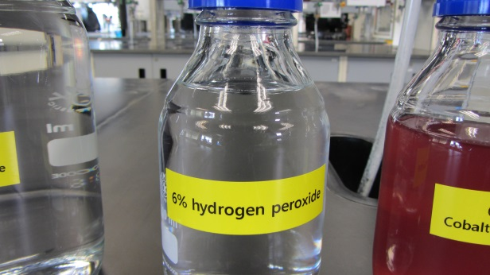
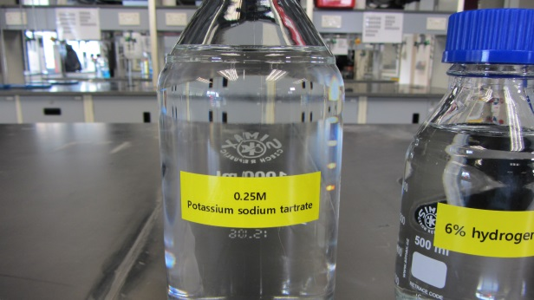
Chemicals
6% hydrogen peroxide solution
0.25 M potassium sodium tartrate solution
0.1 M cobalt(II) chloride solution

Slide 4
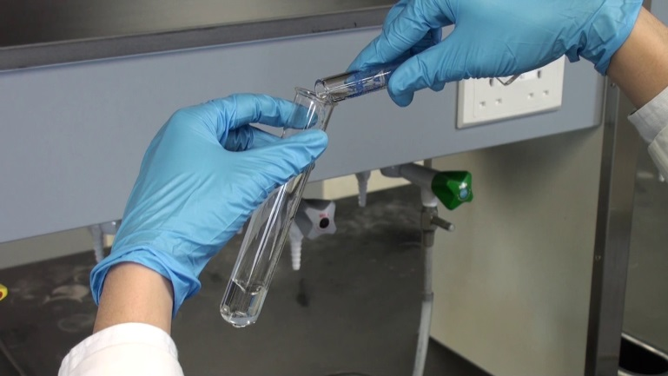
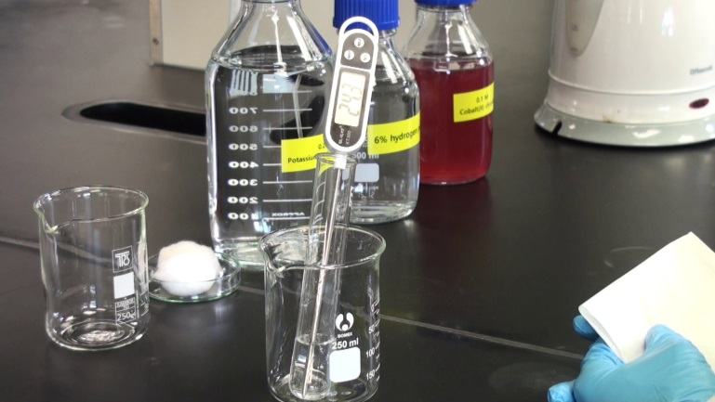
Key Procedure
Pour 10 cm³ of 0.25 M potassium sodium tartrate solution and 3 cm³ of 6% hydrogen peroxide solution into a boiling tube.
Insert a thermometer into the solution and measure the temperature of the solution.

Slide 5
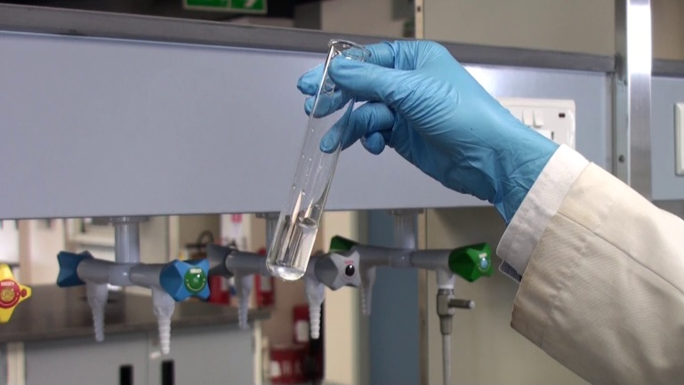
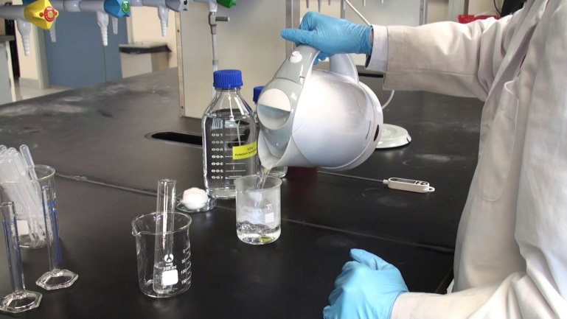
Key Procedure
Gently swirl the boiling tube to mix the content thoroughly.
Fill a 250 cm³ beaker with just-boiled hot water to half full. (electric kettles are shared among few groups)

Slide 6
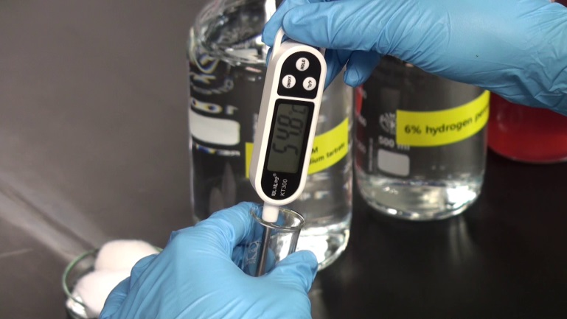
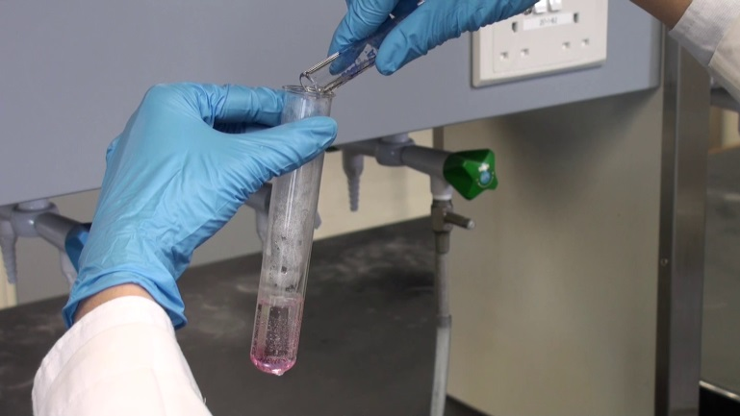
Key Procedure
Place the boiling tube into the beaker to warm the content. Gently swirl the boiling tube until the temperature of the content reaches about 65ºC. (Avoid heating the mixture above 70ºC).
Remove the boiling tube from the hot water bath.
Quickly add 1 cm³ of 0.1 M cobalt(II) chloride solution into the reaction mixture.

Slide 7
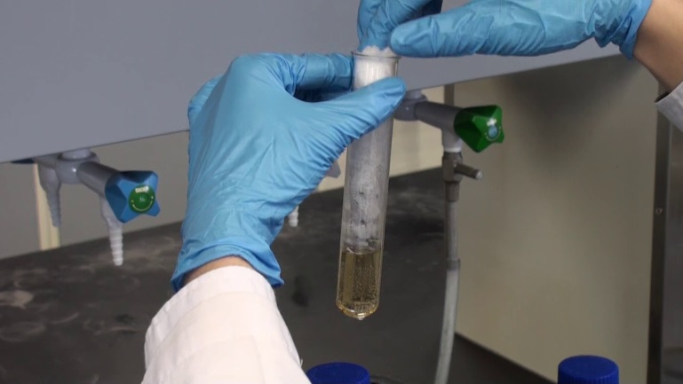
Key Procedure
Immediately place a cotton plug loosely to the mouth of the boiling tube. (The vigorous formation of gas bubbles may cause the content to spill out of the boiling tube.)
Record the observation.

Slide 8
Results
Complete the table after the experiment:
 | Observations
Mixing of potassium sodium tartrate solution and hydrogen peroxide solution at room temperature.
Heating the reaction mixture in the hot water bath.
Addition of cobalt(II) chloride solution into the mixture.

Slide 9
The Determination of Food Dye in Packaged Soft Drinks
To construct a home-made LED colorimeter
To prepare an absorbance-concentration calibration curve for a series of standard solutions of a food dye using LED colorimetry
To determine the amount of food dye present in a packaged soft drink sample by LED colorimetry

Slide 10
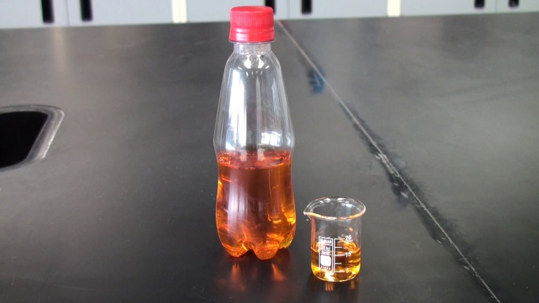
Background
Food dyes are often added into packaged food products to give the product a more appealing colour to attract customers. Colorimetry is a common technique to determine the concentration of a compound in a solution if it has absorbance in the UV-visible range.
The concentration of the coloured species can be determined by light intensity measurement.

Slide 11
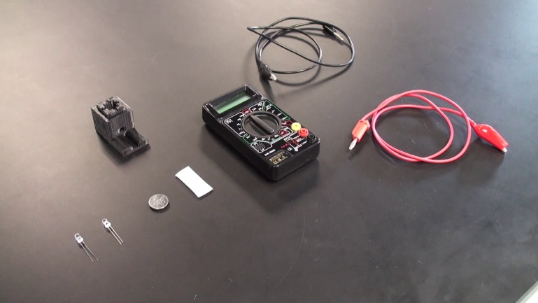
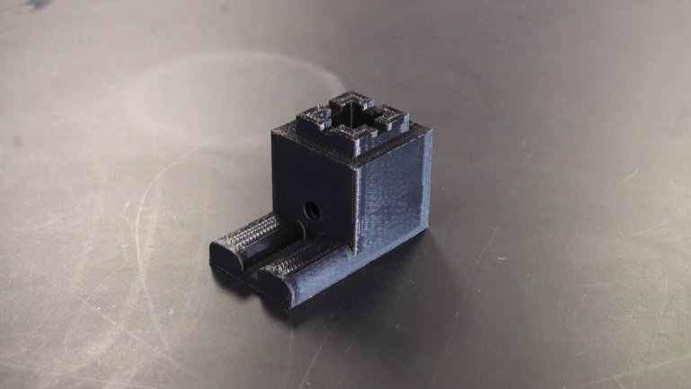
Home-made LED colorimeter
Apparatus for construction of LED colorimeter:
Green LED
Infra-red LED
3V button battery
Connecting wires
Digital voltmeter
Plastic stand (produced by 3D printing)

Slide 12
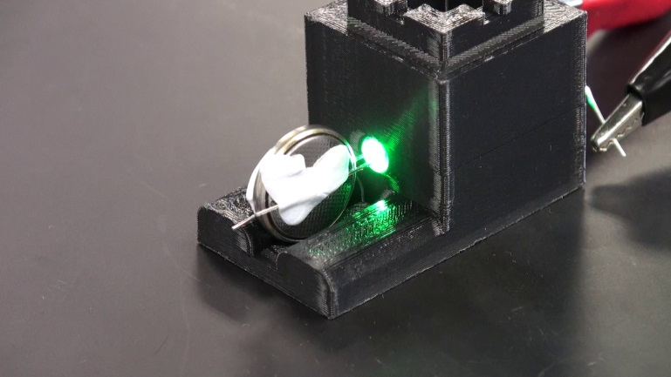
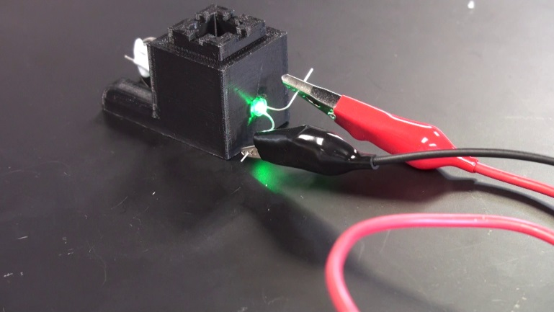
Part A: Construction of LED colorimeter
Insert a button battery between the leads of the green LED. Secure the battery with Blu-tack.
Insert the Green LED into the openings of the plastic stand.
Connect the two leads of IR LED to voltmeter.

Slide 13
Part A: Construction of LED colorimeter

Slide 14
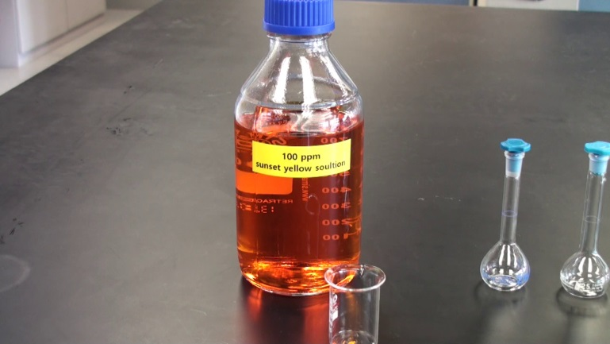
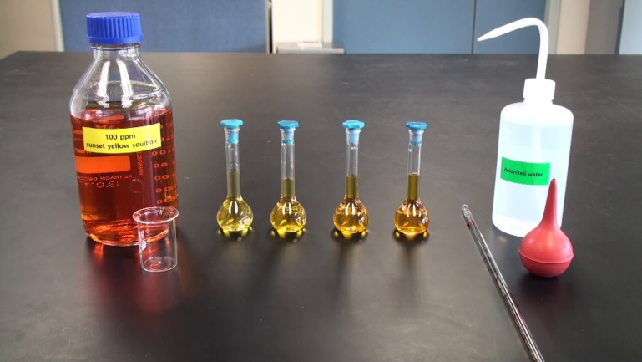
Part B: Preparation of Standard Solutions
Prepare four Sunset Yellow FCF standard solutions by pipetting 5.0, 10.0, 15.0 and 20.0 cm³ of the given Sunset Yellow FCF stock solution into four 25 cm³ volumetric flasks respectively.
Make up to the graduation using deionised water. Five standard solutions: (20 ppm, 40 ppm, 60 ppm, 80 ppm and 100 ppm)

Slide 15
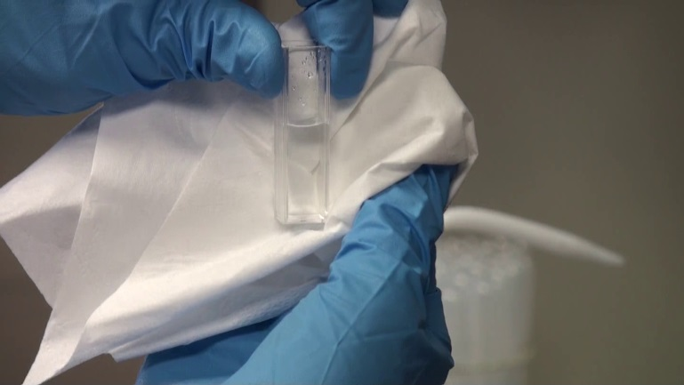
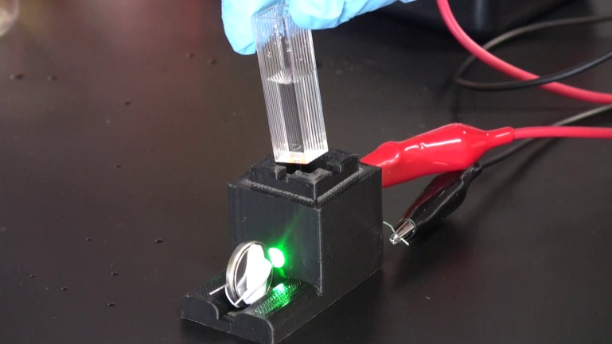
Part C: Measurements for Standard Solutions
Rinse a cuvette and fill it at least half- full with deionised water.
Wipe the outside of the cuvette with a tissue to make sure that the cuvette surfaces are clean and dry.
Place the cuvette in the sample compartment of the colorimeter and record the multimeter reading for the LED detector.

Slide 16
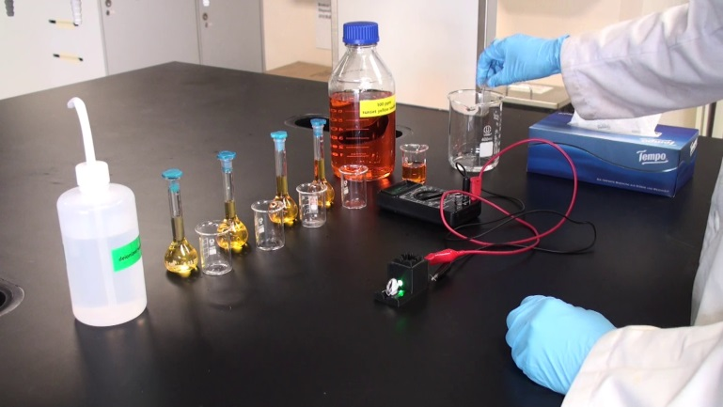
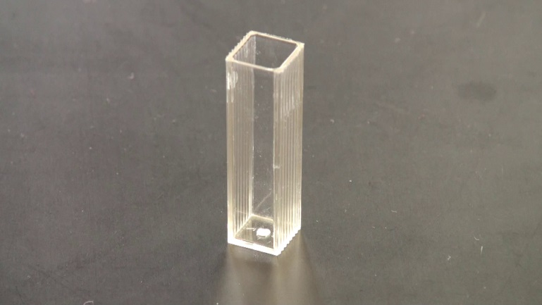
Part C: Measurements for Standard Solutions
Repeat the procedures for the five Sunset Yellow FCF standard solutions you obtained.
Rinse the cuvette with the solution to be measured.

Slide 17
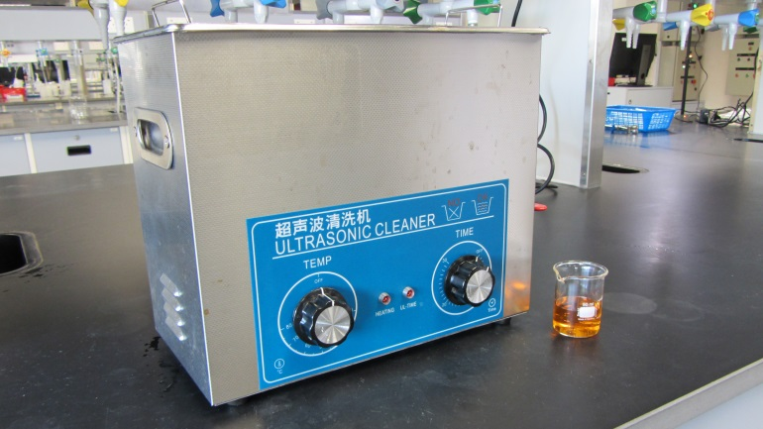
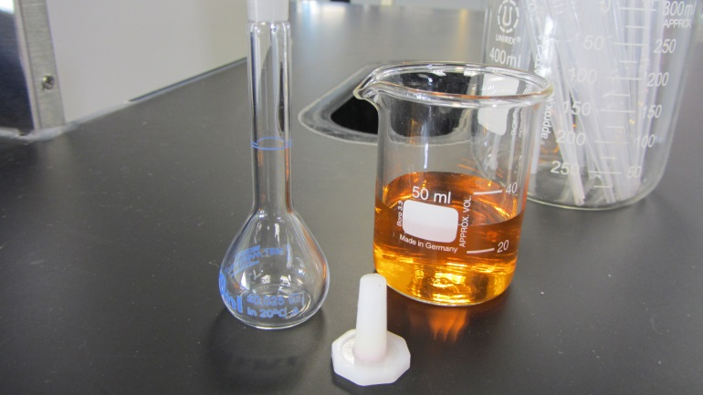
Part D: Measurements for Soft Drink Sample
Degas the packaged soft drink sample using an ultrasonic bath for 10 minutes. (The sample provided has been degased.)
Dilute the soft drink sample by pipetting 5.0 cm³ of the sample solution into 10 cm³ volumetric flask.

Slide 18
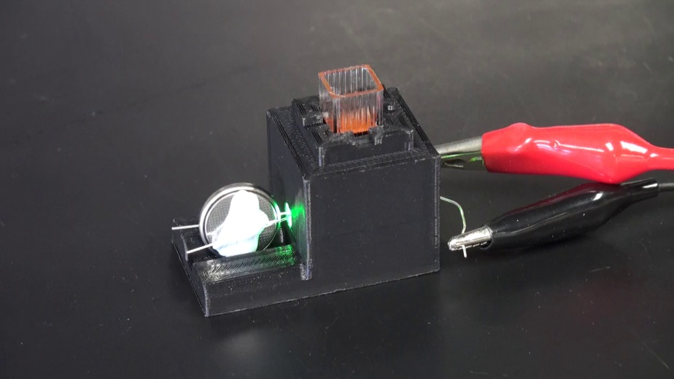
Part D: Measurements for Soft Drink Sample
Rinse a cuvette and fill it at least half-full with the diluted sample.
Place the cuvette in the sample compartment of the colorimeter and record the voltmeter reading for the LED detector.

Slide 19
Results
Complete the following table:
A = log₁₀(I₀ / I_{s}) = log₁₀(V₀ / V_{s})
 | Deionised water | Standard Solution |  |  |  |  | Sample solution
 |  | 20 ppm | 40 ppm | 60 ppm | 80 ppm | 100 ppm
Voltage measured (V₀ or V_{s})
Absorbance (A)

Slide 20
Results
Plot a calibration curve (A vs c) below. Since A ∝ c, a straight line is expected.
Determine the concentration of the food dye in the soft drink sample from the calibration curve.

Slide 21
Reduction of Vanillin with Sodium Borohydride
To carry out the reduction of vanillin to vanillyl alcohol using sodium borohydride as the reducing agent

Slide 22
Background
Sodium borohydride is a mild reducing agent which is very useful for carrying out organic reduction reactions. It is useful for reducing aldehydes and ketones into primary alcohols and secondary alcohols, respectively.
In this experiment, vanillin is reduced to vanillyl alcohol by sodium borohydride (NaBH₄). Vanillin is an aromatic compound found in a spice, vanilla. Sodium borohydride reduces the aldehyde group in vanillin to primary alcohol.

Slide 23
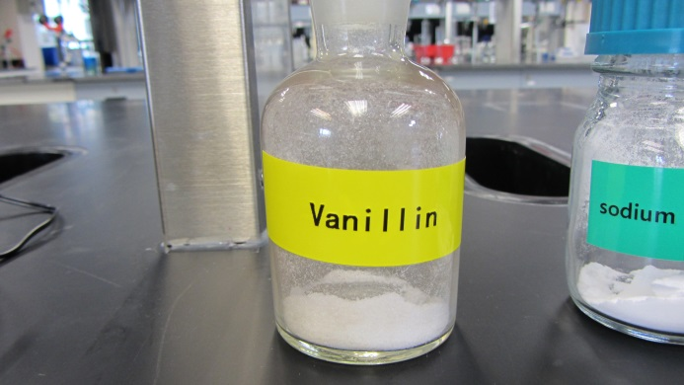
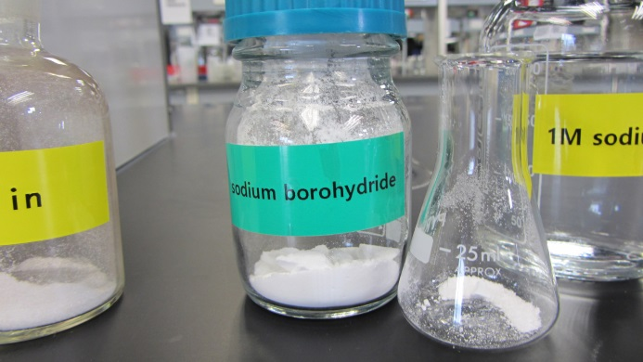
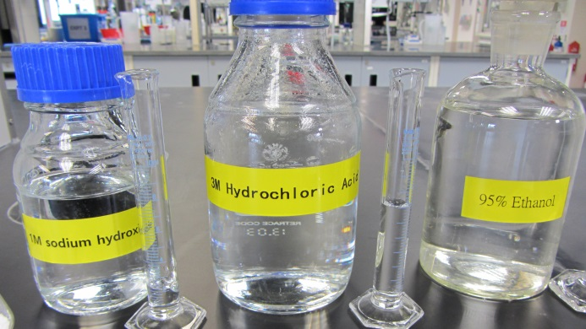
Chemicals
Vanillin
Sodium borohydride
95% ethanol
1M sodium hydroxide
3M hydrochloric acid

Slide 24
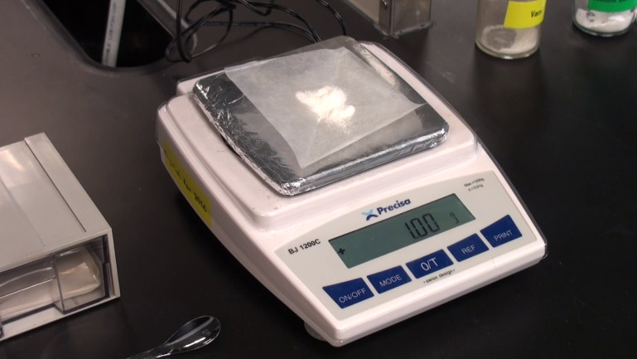
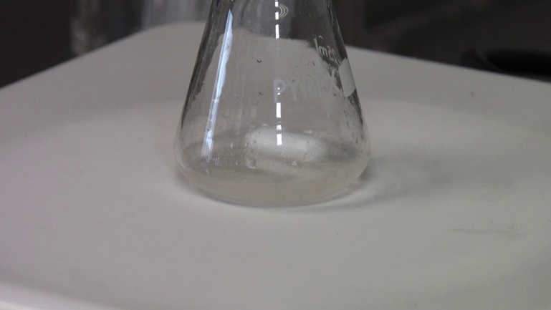
Key Procedure
Weigh accurately 1 g of vanillin solid in a 25 cm³ conical flask.
Add 2 cm³ of 95 % ethanol and a magnetic stir bar into the flask.
Stir the mixture with an electric stir plate at room temperature.

Slide 25
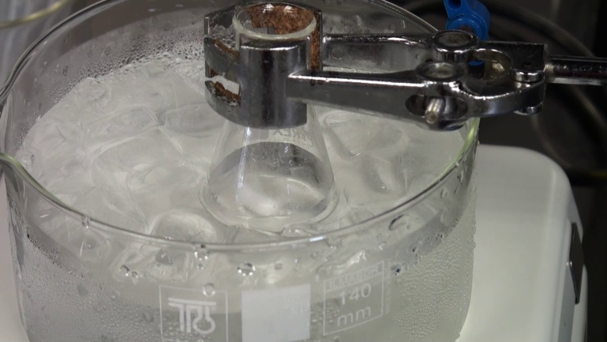
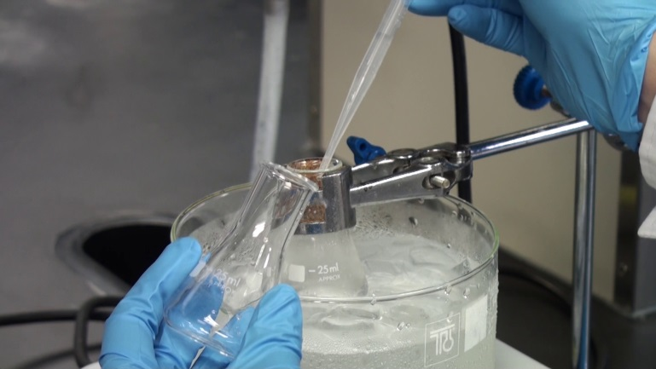
Key Procedure
Cool the mixture in an ice-water bath.
Prepare NaBH₄ solution by dissolving 0.25g of NaBH₄ solid with 1M NaOH.
Slowly add the solution dropwise to the mixture with dropper.

Slide 26
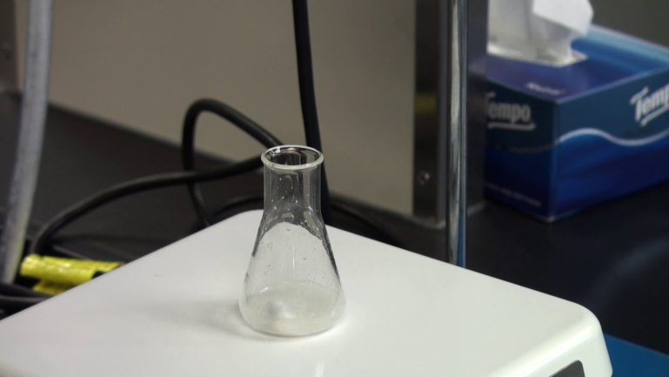
Key Procedure
Remove the flask from the ice-water bath and allow the reaction mixture to be stirred at room temperature for 10 minutes.

Slide 27
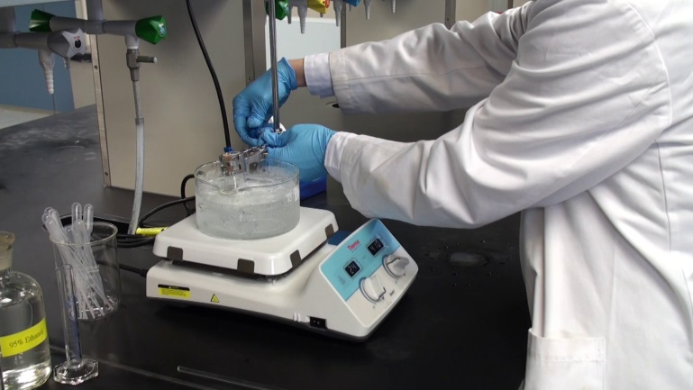
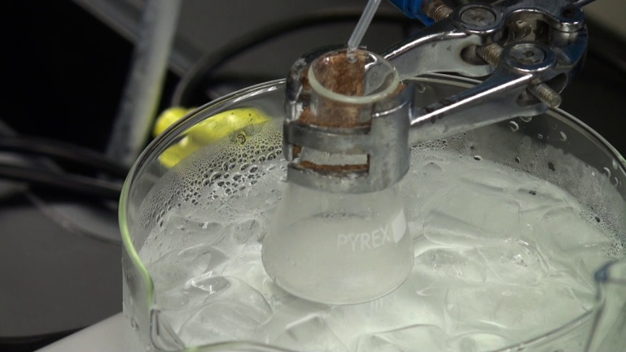
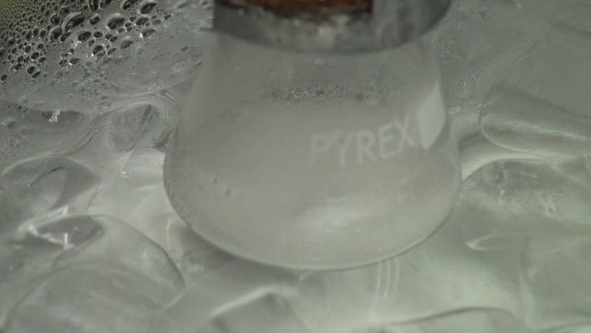
Key Procedure
Cool the reaction mixture again with an ice-water bath.
Add 3M HCl(aq) dropwise to the reaction mixture.
Continue the addition until no more gas evolves from the mixture or until the reaction mixture is acidic. (The acidity can be checked by pH paper.)

Slide 28
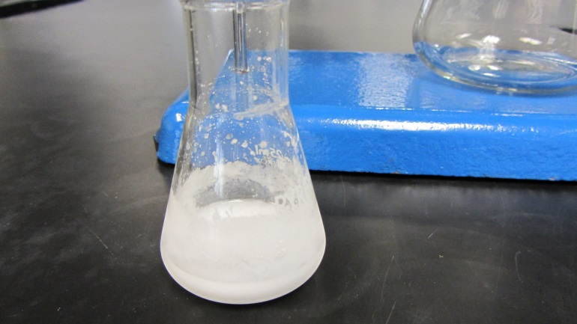
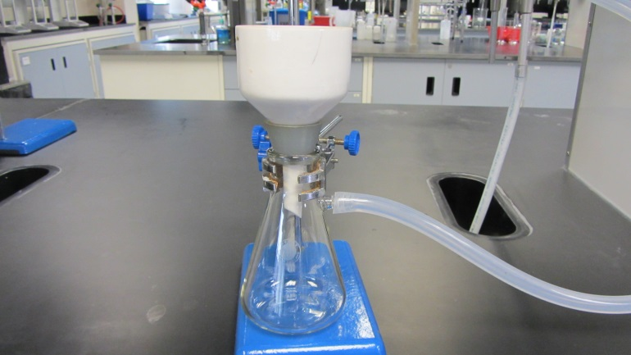
Key Procedure
Cool the mixture with continuous stirring to allow the product to precipitate from the reaction mixture.
Conduct suction filtration.
Wash the product twice with small amount of ice-cold water.

Slide 29
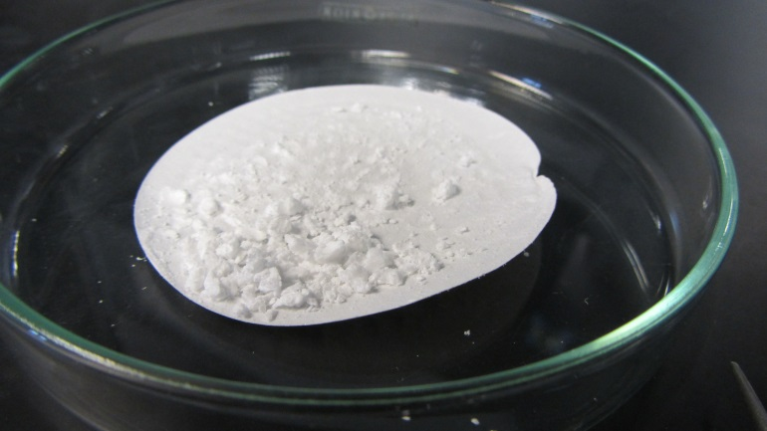
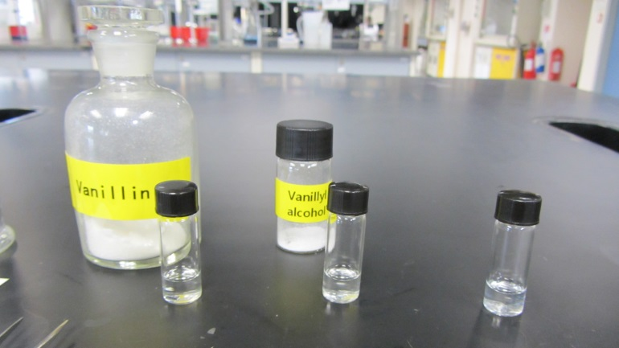
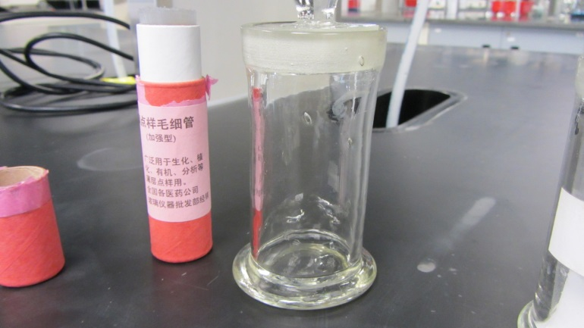
Key Procedure
Prepare the TLC sample by dissolving a small amount of the product in 1 cm³ of propanone in a small test tube. (The authentic solutions of vanillin and vanillyl alcohol were prepared.)
Prepare the TLC chamber by adding an appropriate amount of TLC solvent into the chamber to about 3-4 mm deep. (hexane / ethyl ethanoate 3:2)

Slide 30
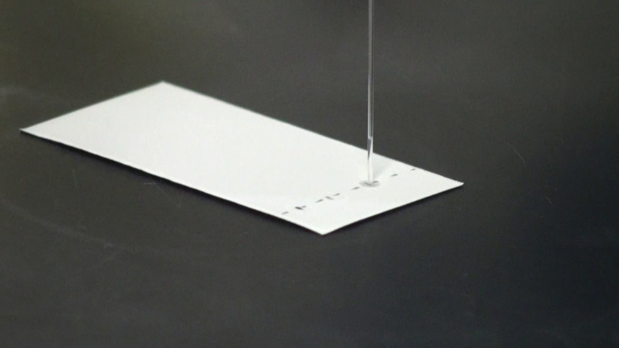
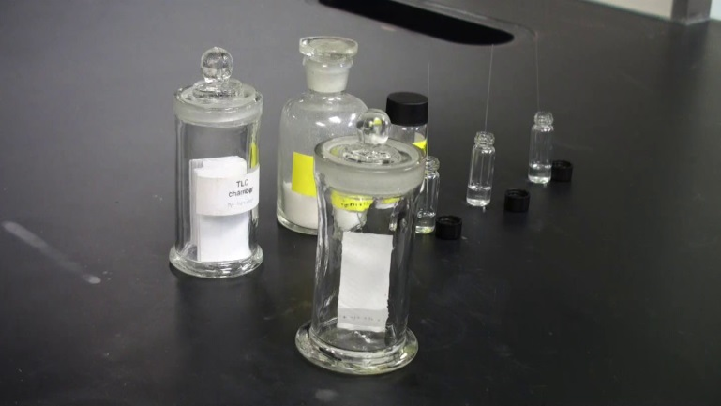
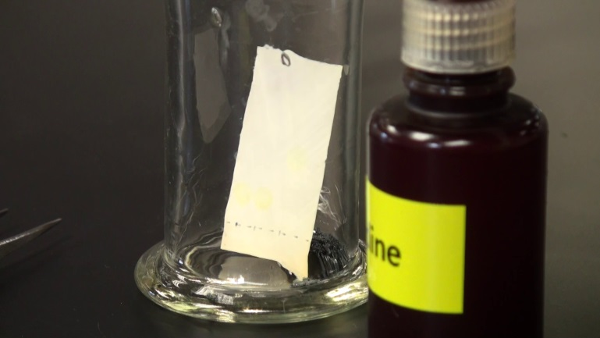
Key Procedure
Spot the sample solution and authentic solutions on a TLC plate by using a capillary tube.
Develop the TLC plate.
Develop again in an iodine chamber.

Slide 31
Results
Complete the following table:
 | Observations
Addition of NaBH₄ solution into vanillin solution cooled in an ice-water bath.
Warming the reaction mixture to room temperature.
Addition of 3 M HCl(aq) into the reaction mixture.
Further cooling of the mixture in the ice-water bath.
The filtrate obtained in the suction filtration.
The product collected in the suction filtration.
The spots on TLC plate before putting into the iodine chamber.
The spots on TLC plate after putting into the iodine chamber.

Slide 32
Results
Draw the TLC result.
Calculate the percentage yield of the reaction.

