Slide 1
List of Experiment Today
Preparation of Nitrogen Monoxide and Study of Its Chemical Properties (microscale experiment)
Making of Silver Nanoparticles
Quantitative Analysis of a Mixture of Carbonates(Inquiry-Based Approach)

Slide 2
Website of Workshop Resources
Resources on June 2017(Today)
Link: http://www.cuhk.edu.hk/proj/science_resource/CHEM02/internal/
Resources on February 2017
Link: http://www.cuhk.edu.hk/proj/science_resource/CHEM01/internal/

Slide 3
Preparation of Nitrogen Monoxide and Study of Its Chemical Properties (microscale experiment)
Curriculum Link
Topic VII
Redox Reactions, Chemical Cells and Electrolysis

Slide 4
Background
Nitrogen monoxide (NO) is a colourless gas. It can be prepared by the reaction of sodium nitrite with acidified iron(II) sulphate solution:
Nitrogen monoxide is very reactive and is readily oxidised in air to produce nitrogen dioxide:

Slide 5
Background
Nitrogen monoxide has a very limited solubility in water.
The oxidation state of nitrogen in nitrogen monoxide (NO) is +2. Since typical oxidation state of nitrogen ranges from -3 to +5, nitrogen monoxide has both oxidising and reducing properties with suitable reagents.

Slide 6
Tasks
To prepare nitrogen monoxide from sodium nitrite and acidified iron(II) sulphate solution.
To study the oxidising and reducing properties of nitrogen monoxide with (1) acidified potassium permanganate solution, (2) bromine water, (3) acidified iron(II) sulphate solution, and (4) air (oxygen).

Slide 7
Chemicals
NaNO₂(s)
FeSO₄/H⁺(aq)
1 M NaOH(aq)
KMnO₄/H⁺(aq)
Br₂(aq)
Deionised water

Slide 8
Part A: Preparation of Nitrogen Monoxide
1. Add 250 cm³ of deionised water into a 250 cm³ beaker.
2. Pour about 100 cm³ of 1 M NaOH solution into another 250 cm³ beaker.
1 M NaOH
solution
deionised water

Slide 9
Part A: Preparation of Nitrogen Monoxide
3. Carry out the following for a 100 cm³ glass syringe:
(a) Insert the plunger into the syringe, and push and pull the plunger several times. Check whether the plunger moves smoothly in the syringe.

Slide 10
Part A: Preparation of Nitrogen Monoxide
3. (b) Cap the syringe with the syringe cap or your finger and check whether the plunger moves smoothly in the syringe. If it does, there may be a leakage and then you should ask for help.

Slide 11
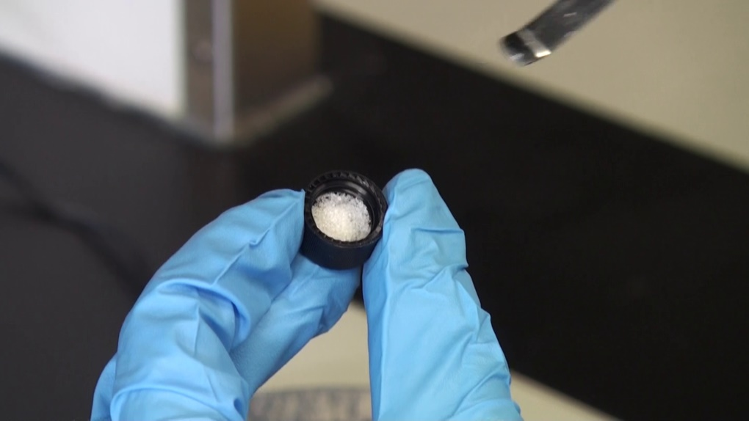
Part A: Preparation of Nitrogen Monoxide
4. (a) Weigh about 0.25 g of NaNO₂(s) with an electronic balance and transfer it into a vial cap. Make sure that the NaNO₂ solid is evenly placed in the cap.

Slide 12
Part A: Preparation of Nitrogen Monoxide
4. (b) With the syringe tip pointing down without plunger, cap the tip, fill the upright-syringe with water. Put the vial cap prepared in (a) on the water surface.

Slide 13
Part A: Preparation of Nitrogen Monoxide
4. (c) Uncap the syringe to allow water to drain out from the syringe. After water drains out completely, the vial cap should sit at the bottom inside the syringe. From now on, always keep the syringe in an up-right position with tip pointing down.

Slide 14
Part A: Preparation of Nitrogen Monoxide
5. Insert the plunger into the syringe with the tip of the plunger touching the vial cap, and draw about 4 cm³ of acidified FeSO­₄(aq) into the syringe.
6. Cap the syringe immediately.

Slide 15
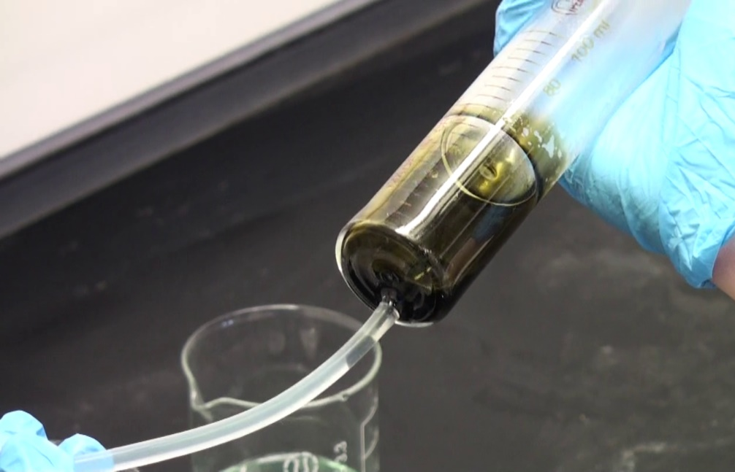
Part A: Preparation of Nitrogen Monoxide
7. Shake the syringe gently to mix the NaNO₂(s) and the acidified FeSO₄(aq).
To prevent the reaction from going too fast, you should stop shaking when the reaction goes. Only when the reaction stops or goes slowly should you shake the syringe again. In case the amount of the nitrogen monoxide gas generated is more than the syringe can contain, let the plunger move out of the syringe (but with your hand holding the plunger to avoid falling) and allow excess gas to escape from the syringe.

Slide 16
Part A: Preparation of Nitrogen Monoxide
8. When the production of NO(g) is finished, hold the plunger and remove the syringe cap carefully.
Discharge the solution inside the syringe into the 1M NaOH solution.

Slide 17
Part A: Preparation of Nitrogen Monoxide
9. To wash away the contaminants from the collected NO(g) with deionised water, draw about 10 cm³ of deionised water into the syringe. Cap the syringe again and shake or swirl the syringe to wash the gas inside the syringe. Remove the cap and discharge the water from the syringe into the 1M NaOH solution.

Slide 18
Part A: Preparation of Nitrogen Monoxide
10. Repeat step 9 for 2 to 3 times. Cap the syringe with the syringe cap, and the preparation of NO(g) is done.

Slide 19
Part B: Study of the Oxidising and Reducing Properties of Nitrogen Monoxide
1. Add 5 cm³ of acidified KMnO₄(aq), Br₂(aq), and acidified FeSO₄(aq) to 3 test tubes respectively.

Slide 20
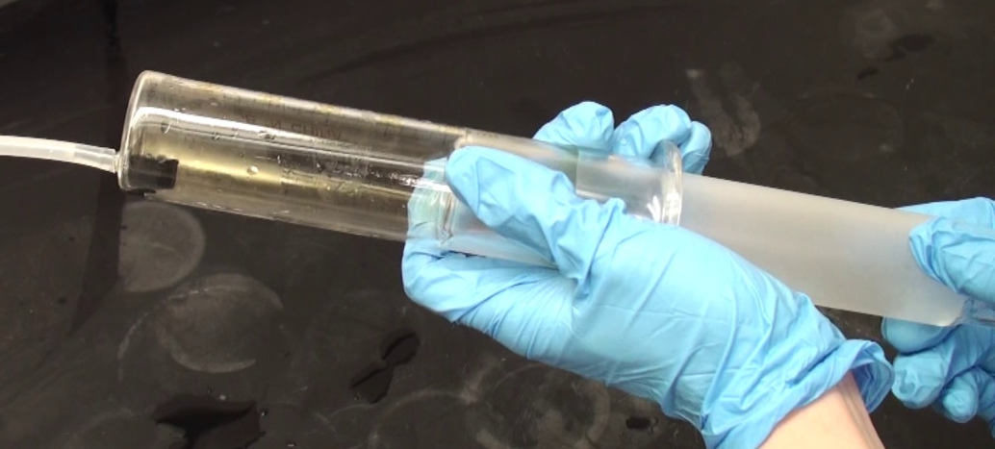
Part B: Study of the Oxidising and Reducing Properties of Nitrogen Monoxide
2. Inject a small amount of nitrogen monoxide from the syringe into each of the solutions.
3. With NO(g) left in the syringe, suck in small amount of air into the syringe by pulling the plunger slowly.

Slide 21
Results
Record your observations in the table:
 | Observations
Appearance of the solid NaNO₂.
Appearance of the acidified FeSO₄ solution.
Mixing NaNO₂(s) with acidified FeSO₄ solution.
Washing NO(g) with deionised water.
Appearance of NO(g).
Before and after adding NO(g) to (1) acidified KMnO₄(aq).
(2) Br₂(aq).
(3) acidified FeSO₄(aq).
After mixing NO(g) with air (O₂(g)).

Slide 22
Results
Answer the questions after the experiment:
1. In the reaction between NaNO₂(s) and FeSO₄(aq)/H⁺(aq),
(a) which one is the limiting reagent? Given: The FeSO₄ solution is prepared by dissolving 33.8 g of FeSO₄·7H₂O in 90 cm³ of water, followed by addition of 10 cm³ of concentrated sulphuric acid.
(b) calculate the theoretical volume of NO(g) produced. Assume the gas is produced under room temperature and pressure.
(c) which one is the oxidising reagent and which one is the reducing reagent? Explain your answer in terms of the changes in oxidation numbers.
(d) Write down the half-equations for the oxidation and reduction occurred in the reaction between NaNO₂(s) and FeSO₄(aq)/H⁺(aq).
(e) What is the observable change occurred in the reaction between NO(g) and FeSO₄(aq)/H⁺(aq)? Write a balanced equation for the reaction.
2. What is the observable change occurred in the reaction between NO(g) and acidified KMnO₄(aq)? Write a balanced equation for the reaction.
3. What is the observable change occurred in the reaction between NO(g) and Br₂(aq)? Write a balanced equation for the reaction.
4. What is the observable change occurred in the reaction between NO(g) and O₂(g)? Write a balanced equation for the reaction.

Slide 23
Making of Silver Nanoparticles
Curriculum Link
Topic XIV
Materials Chemistry

Slide 24
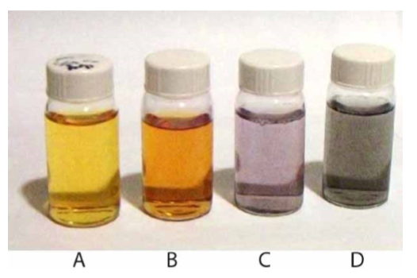
Background
Nanomaterials are organic or inorganic materials that have particle sizes below 100 nm, they have properties that are very different from those of the bulk materials.
For example, silver is a metal. It has a silvery and metallic appearance. When dispersed in water, very fine powder of silver material looks grey (‘D’ in the figure). But the colour of silver nanoparticle is yellow or bright yellow (‘A’ in the figure).

Slide 25
Making of Silver Nanoparticles
Sodium borohydride acts as a reducing agent to reduce the Ag⁺ ions into silver metal.
Silver nanoparticles are formed, and then stabilised by sodium borohydride, further growing to particles with bulk size is suppressed (∵repulsive electrostatic forces).

Slide 26
Different stages of aggregation
By changing the size, shape, composition and the level of aggregation of the nanoparticles, the light absorbing and scattering properties, and so the perceived colour can be tuned accordingly.
Increasing the level of aggregation of silver nanoparticles

Slide 27
Tasks
To synthesise silver nanoparticles from silver nitrate solution and sodium borohydride solution.
To observe the colour of the solution of the silver nanoparticles.
To study the aggregation of the silver nanoparticles in the solution prepared.

Slide 28
Chemicals
0.0010 M AgNO₃(aq)
0.0020 M NaBH₄(aq)
Saturated NaCl(aq)

Slide 29
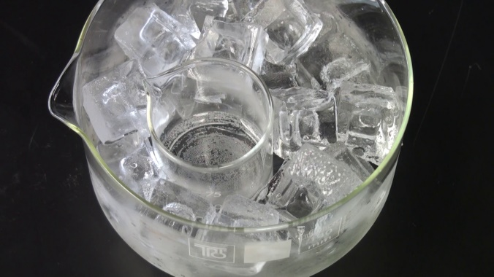
Part A: Synthesis of Silver Nanoparticles
1. Use a measuring cylinder to measure 30 cm³ of 0.0020 M sodium borohydride solution, and pour the solution into a 100 cm³ beaker.
2. Place the beaker into an ice bath. Cool the solution in the ice bath for about 5-10 minutes.

Slide 30
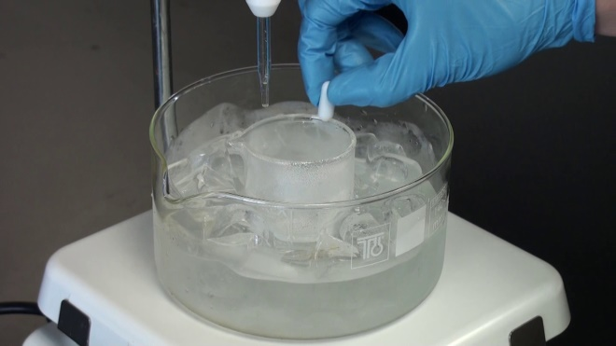
Part A: Synthesis of Silver Nanoparticles
3. Use a clean measuring cylinder to measure 10 cm³ of 0.0010 M AgNO₃ solution and transfer the solution into a burette.
4. Stir the NaBH₄ solution in the beaker with a magnetic stirrer bar or a glass rod.

Slide 31
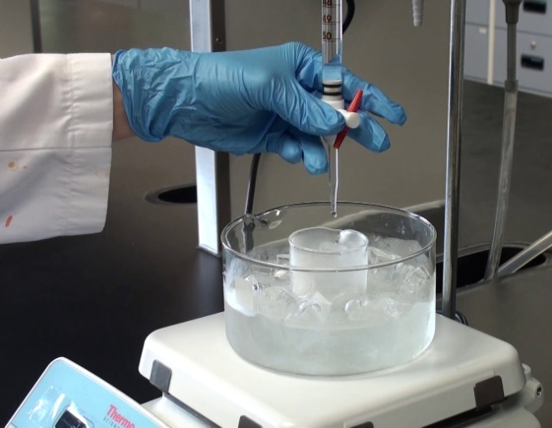
Part A: Synthesis of Silver Nanoparticles
5. With the beaker containing NaBH₄ solution still in the ice bath, add the AgNO₃ solution dropwise from the burette to the NaBH₄ solution in the beaker with continuous stirring, at a rate of about 1 drop per second, until the silver nitrate solution is used up.
6. Stop the stirring as soon as the addition of silver nitrate solution is finished, and remove the stirrer bar or glass rod from the mixture.

Slide 32
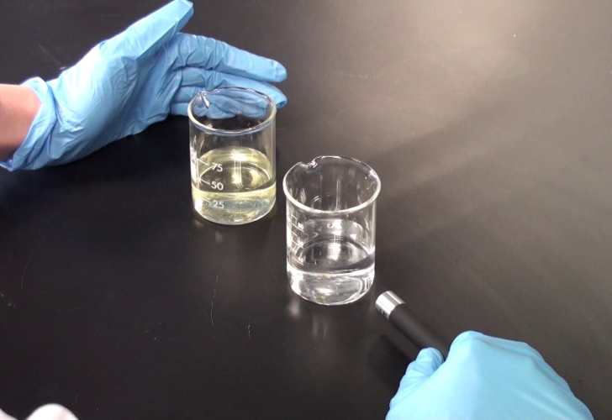
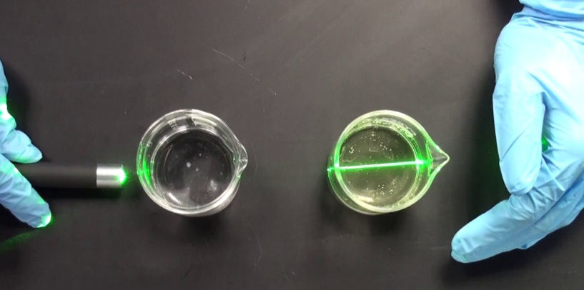
Part B: Study the Properties of the Silver Nanoparticles
1. Right after the silver nanoparticles are prepared, place the beaker containing the nanoparticles and a 100 cm³ beaker containing about 40 cm³ water side by side.
2. Turn on a laser pointer from sideway such that the laser beam goes through both the solutions in the beakers.

Slide 33
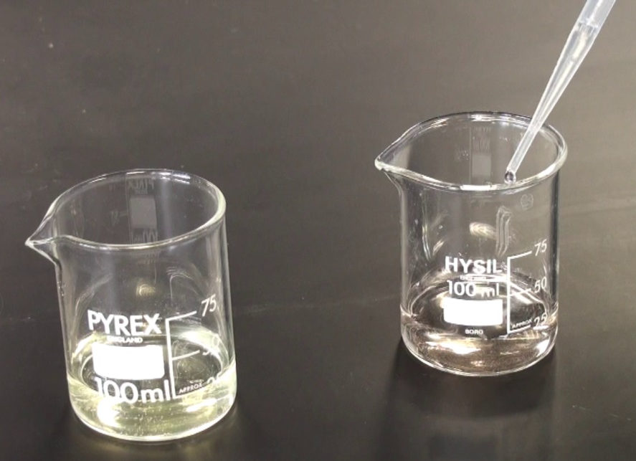
Part B: Study the Properties of the Silver Nanoparticles
3. Transfer about half of the silver nanoparticle solution into another 100 cm³ beaker, add about 10 cm³ of saturated NaCl solution into the beaker.

Slide 34
Results
Record your observations in the table:
 | Observations
Appearance of the 0.0010M silver nitrate solution.
Appearance of the 0.0020 M sodium borohydride solution.
Addition of AgNO₃ solution to the NaBH₄ solution.
When the addition of AgNO₃ solution is finished.
When the laser beam goes through the water in beaker.
When the laser beam goes through the silver nanoparticle solution in beaker.
When NaCl solution is added to the silver nanoparticle solution.

Slide 35
Results
Answer the questions after the experiment:
1. What is the oxidation number of silver in (a) silver nitrate and (b) silver nanoparticles?
2. Write a half equation for Ag in the reaction.
3. What is/are the role(s) of NaBH₄ in the solution?
4. State, with explanation, one important precaution when using NaBH₄.
5. Is there any observed difference when a laser beam goes through the silver nanoparticle solution in beaker and water in beaker. Explain the difference(s) if any.
6. Explain why silver nanoparticles give a colour.
7. Explain why the bright yellow silver nanoparticles turn into gray precipitates when sodium chloride solution is added.

Slide 36
Solution v.s. colloid v.s. suspension
Property | Solution | Colloid | Suspension
Particle size | Less than 1 nm | 1 to 100 nm | Moe than 100 nm
Homogeneity | Homogeneous | Homogeneous or heterogeneous | Heterogeneous
Transparency | Transparent | Often translucent and opaque but can be transparent | Often opaque but can be translucent
Separation | Does not separate | Does not separate | Separates or settles
Filterability | Passes through filter paper | Passes through filter paper | Particles do not pass through filter paper
Examples | Salt solution | Milk | Muddy water
In this experiment, a colloid is formed in which insoluble silver nanoparticles are dispersed uniformly throughout the solution.

Slide 37
Quantitative Analysis of a Mixture of Carbonates (Inquiry-Based Approach)
Curriculum Link
Topic IV
Acids and Bases

Slide 38
Background
You are given a sample of white powder. It is a mixture of potassium carbonate and calcium carbonate, but the percentages of the two compounds are not known.

Slide 39
Tasks
To propose an experimental method to determine the ratio of potassium carbonate and calcium carbonate present in an unknown sample.
To carry out an experiment to find out the ratio of potassium carbonate and calcium carbonate in the mixture.
To compare and discuss the results obtained from other students or groups who carry out the determination with different methods.

Slide 40
Apparatus provided
Filter funnel
Glass rod
100 cm³ Beaker
250 cm³ Beaker
250 cm³ Conical flasks
50 cm³ Pipette
Burette
50 cm³ Measuring cylinder
White tile
Hot plate
Stirrer bar
Spatula
Electronic balance
Oven
Filter papers
Disposable droppers

Slide 41
Chemicals provided
0.200 M standard HCl(aq)
1.000 M standard HCl(aq)
0.200 M standard NaOH(aq)
1.0 M BaCl₂(aq)
Methyl orange indicator
Phenolphthalein indicator
Deionised water
Sample (Mixture of potassium and calcium carbonates)

Slide 42
Results
Method | Mass % of K₂CO₃ | Mass % of CaCO₃
1
2A
2B
3 (Direct Titration)
4 (Back Titration)

Slide 43
Discussions
What is your experimental method?
What are the advantages and disadvantages of your experimental method?
Why do you choose to carry out this experimental method?
Are there any experimental errors/difficulties encountered in your experiment?

Slide 44
Possible Methods
Method 1 (Measure the mass of insoluble CaCO₃ residue after filtration)
Method 2A (Precipitation between BaCl₂ and filtrate)
Method 2B (Titration between filtrate and standard strong acid)
Method 3 (Direct Titration)
Method 4 (Back Titration)

Slide 45
Method 1 (Measure the mass of insoluble CaCO₃ residue)
Potassium carbonate is soluble in water; calcium carbonate is insoluble.
To find out the mass of calcium carbonate in the sample.
Mixture of K₂CO₃ and CaCO₃
Mixture of K₂CO₃ and CaCO₃
Dissolve in water,
Filtration
Dissolve in water,
Filtration
K₂CO₃ (aq) (filtrate)
CaCO₃ (s) (residue)
K₂CO₃(aq) (filtrate)
CaCO₃(s) (residue)
Titrate against
standard strong acid
Excess BaCl₂(aq),
Filtration
Titrate against
standard strong acid
Dry and weigh the insoluble CaCO₃
Dry and weigh
No. of mole of CO₃²⁻in K₂CO₃
Dry and weigh the insoluble BaCO₃
No. of mole of CO₃²⁻in K₂CO₃
Dry and weigh the insoluble BaCO₃

Slide 46
Method 2A (Precipitation between BaCl₂ and filtrate)
Barium carbonate is insoluble.
To find out the amount of carbonate ions in soluble potassium carbonate.
Mixture of K₂CO₃ and CaCO₃
Mixture of K₂CO₃ and CaCO₃
Dissolve in water,
Filtration
Dissolve in water,
Filtration
K₂CO₃ (aq) (filtrate)
CaCO₃ (s) (residue)
K₂CO₃(aq) (filtrate)
CaCO₃(s) (residue)
Titrate against
standard strong acid
Excess BaCl₂(aq),
Filtration
Titrate against
standard strong acid
Dry and weigh the insoluble CaCO₃
Dry and weigh
No. of mole of CO₃²⁻in K₂CO₃
Dry and weigh the insoluble BaCO₃
No. of mole of CO₃²⁻in K₂CO₃
Dry and weigh the insoluble BaCO₃

Slide 47
Remarks on Method 1 and 2A
For convenience, it is advised to weigh the filter paper before carrying out the filtration, and then weigh the total mass of the filter paper and residue after filtration and drying. The mass of residue can be determined from the difference between the two mass readings. Collect the residue from the filter paper and then weigh the residue collected will induce a large experimental error because a lot of residue would stick firmly on the filter paper.
To increase the accuracy of the results, it is advised to heat the residue on filter paper in an oven at 110ºC for at least 30 minutes before weighing, to ensure the residue and the filter paper are dried completely.

Slide 48
Method 2B (Titration between filtrate and standard strong acid)
To find out the amount of carbonate ions in soluble potassium carbonate
Use methyl orange as the indicator.
Mixture of K₂CO₃ and CaCO₃
Mixture of K₂CO₃ and CaCO₃
Dissolve in water,
Filtration
Dissolve in water,
Filtration
K₂CO₃ (aq) (filtrate)
CaCO₃ (s) (residue)
K₂CO₃(aq) (filtrate)
CaCO₃(s) (residue)
Titrate against
standard strong acid
Excess BaCl₂(aq),
Filtration
Titrate against
standard strong acid
Dry and weigh the insoluble CaCO₃
Dry and weigh
No. of mole of CO₃²⁻in K₂CO₃
Dry and weigh the insoluble BaCO₃
No. of mole of CO₃²⁻in K₂CO₃
Dry and weigh the insoluble BaCO₃

Slide 49
Method 3 (Direct titration)
To find out the total amount of carbonate ions present in the sample.
Use methyl orange as the indicator.
Mixture of K₂CO₃ and CaCO₃
Dissolve in water
K₂CO₃(aq) + CaCO₃(s)
Titrate against
standard strong acid
Known amount of
excess strong standard acid HCl
Total amount of carbonate ions
KCl(aq) + CaCl₂(aq) + acid
Titrate against standard alkali
Total amount of carbonate ions

Slide 50
Method 4 (Back titration)
To find out the total amount of carbonate ions present in the sample.
Use phenolphthalein as the indicator.
Mixture of K₂CO₃ and CaCO₃
Dissolve in water
K₂CO₃(aq) + CaCO₃(s)
Titrate against
standard strong acid
Known amount of
excess strong standard acid HCl
Total amount of carbonate ions
KCl(aq) + CaCl₂(aq) + acid
Titrate against standard alkali
Total amount of carbonate ions

Slide 51
Remarks on Methods 3 and 4
For methods 3 (direct titration), the determination of end-point is difficult due to various reasons, such as the poor solubility of calcium carbonate in water. However, the accuracy of this method is comparable with other methods so it is not excluded.
Back titration technique is not required in DSE Chemistry curriculum, but its determination of end-point was easier in our trials.

Slide 52
Other methods measuring volume of CO₂(g) produced
Results are not satisfactory, due to reasons like the leakage of gas and the solubility of CO₂(g) in solution.
These two methods are not recommended.
Mixture of K₂CO₃ and CaCO₃
+ HCl
KCl(aq) + CaCl₂(aq) +H₂O(l) + CO₂(g)
Measure the volume of CO₂ gas produced
Measure the loss of mass in the sample due to the loss of CO₂ gas

Slide 53
Summary of results
Method | Mass % of K₂CO₃ | Mass % of CaCO₃
1 | 64 | 36
2A | 50 | 50
2B | 55 | 45
3 (Direct Titration) | 62 | 38
4 (Back Titration) | 63 | 37

Slide 54
Solving simultaneous linear equations in 2 unknowns
http://www.webmath.com/solver2.html

